Slide 1
Controlling Electron Spins in Quantum Dots
Vladimir Shulyak

Slide 2
Why Quantum Dots?
Single electron - confine in 3 dimensions
Electron spin control - programmable qubit
Superposition of spin up and spin down states
Quantum computation
Integrate into circuits

Slide 3
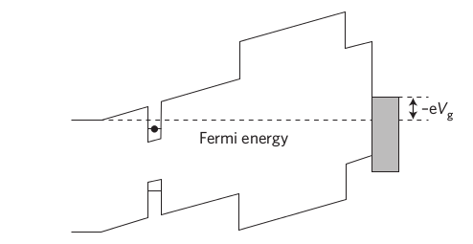
Control Techniques
First charge quantum dot – single electron
Align spins with static magnetic field $B_{0}$
Send microwave pulses using resonator coil
Rotate spins away $B_{0}$

Slide 4
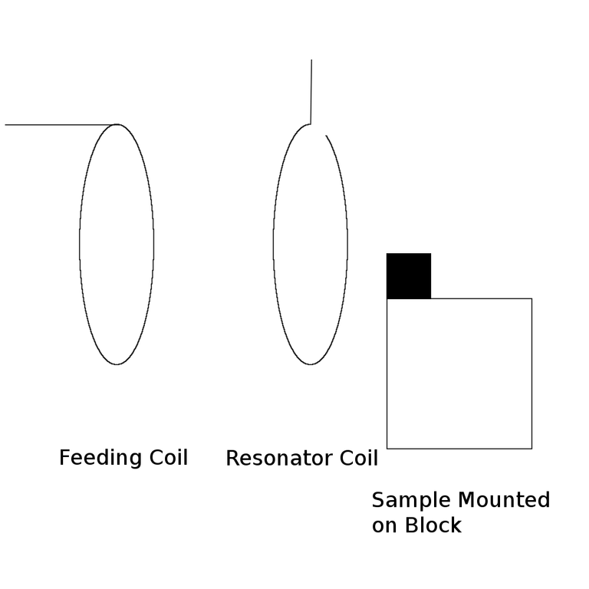
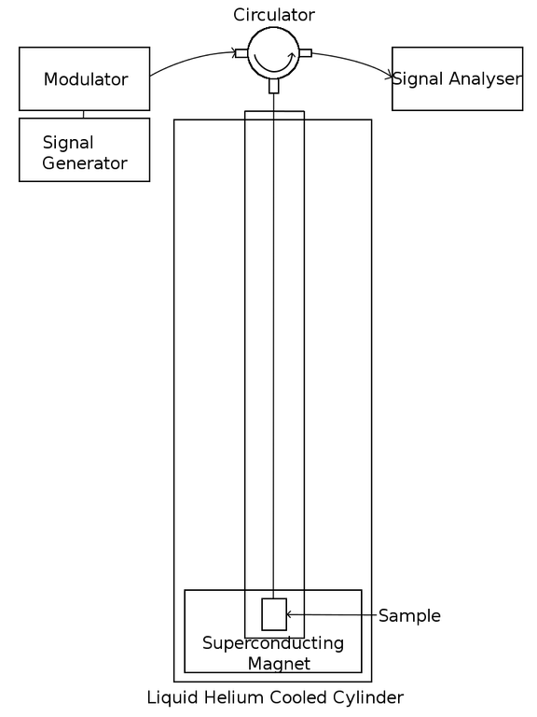
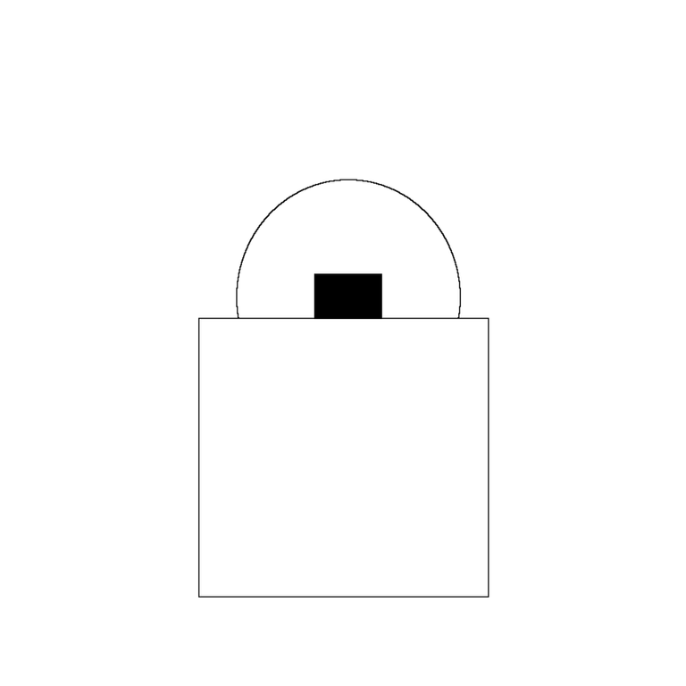
Experimental Setup

